Slide 1
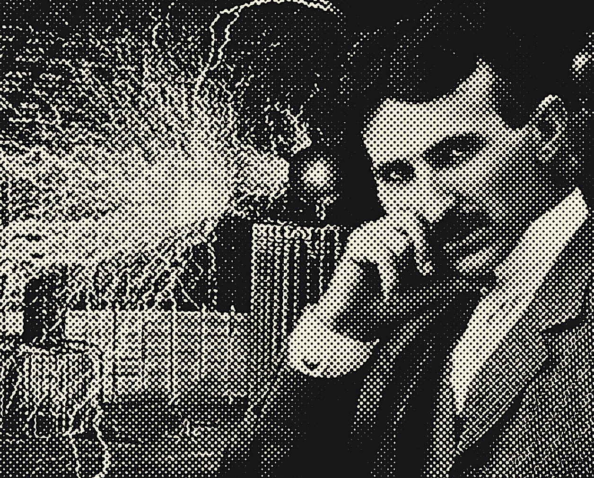
Tesla
Daniele Toniolo
and other two guys

Slide 2
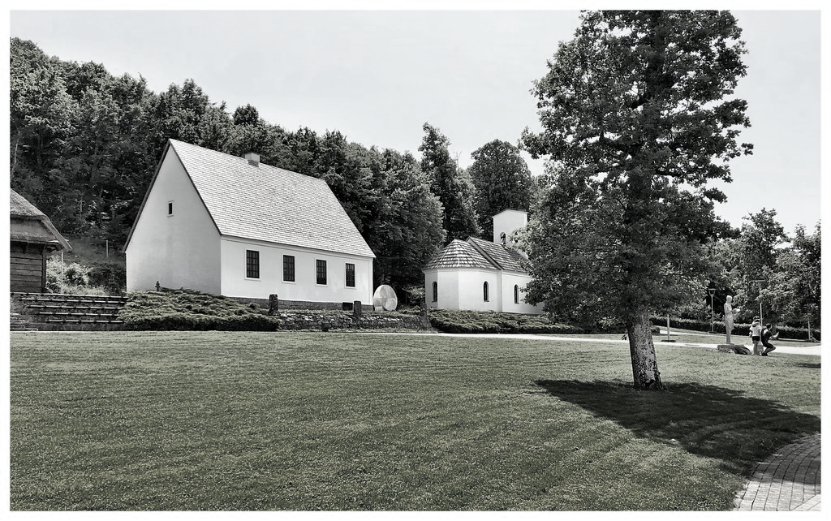
1856
Born in Smiljan

Slide 3
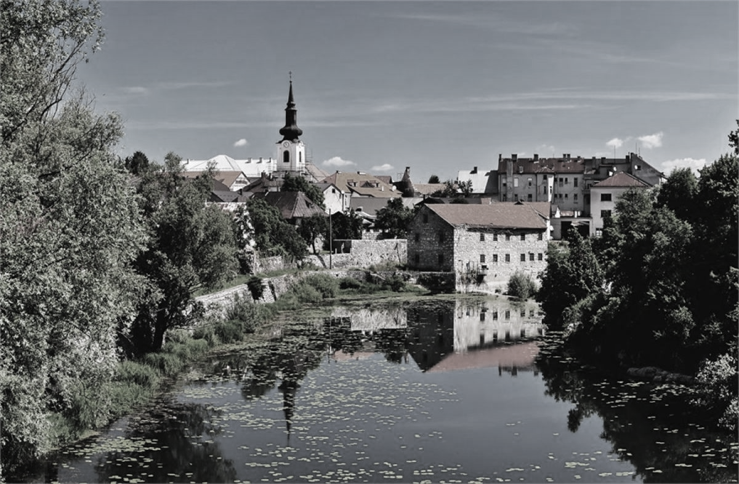
1865
Grown in Gospic

Slide 4
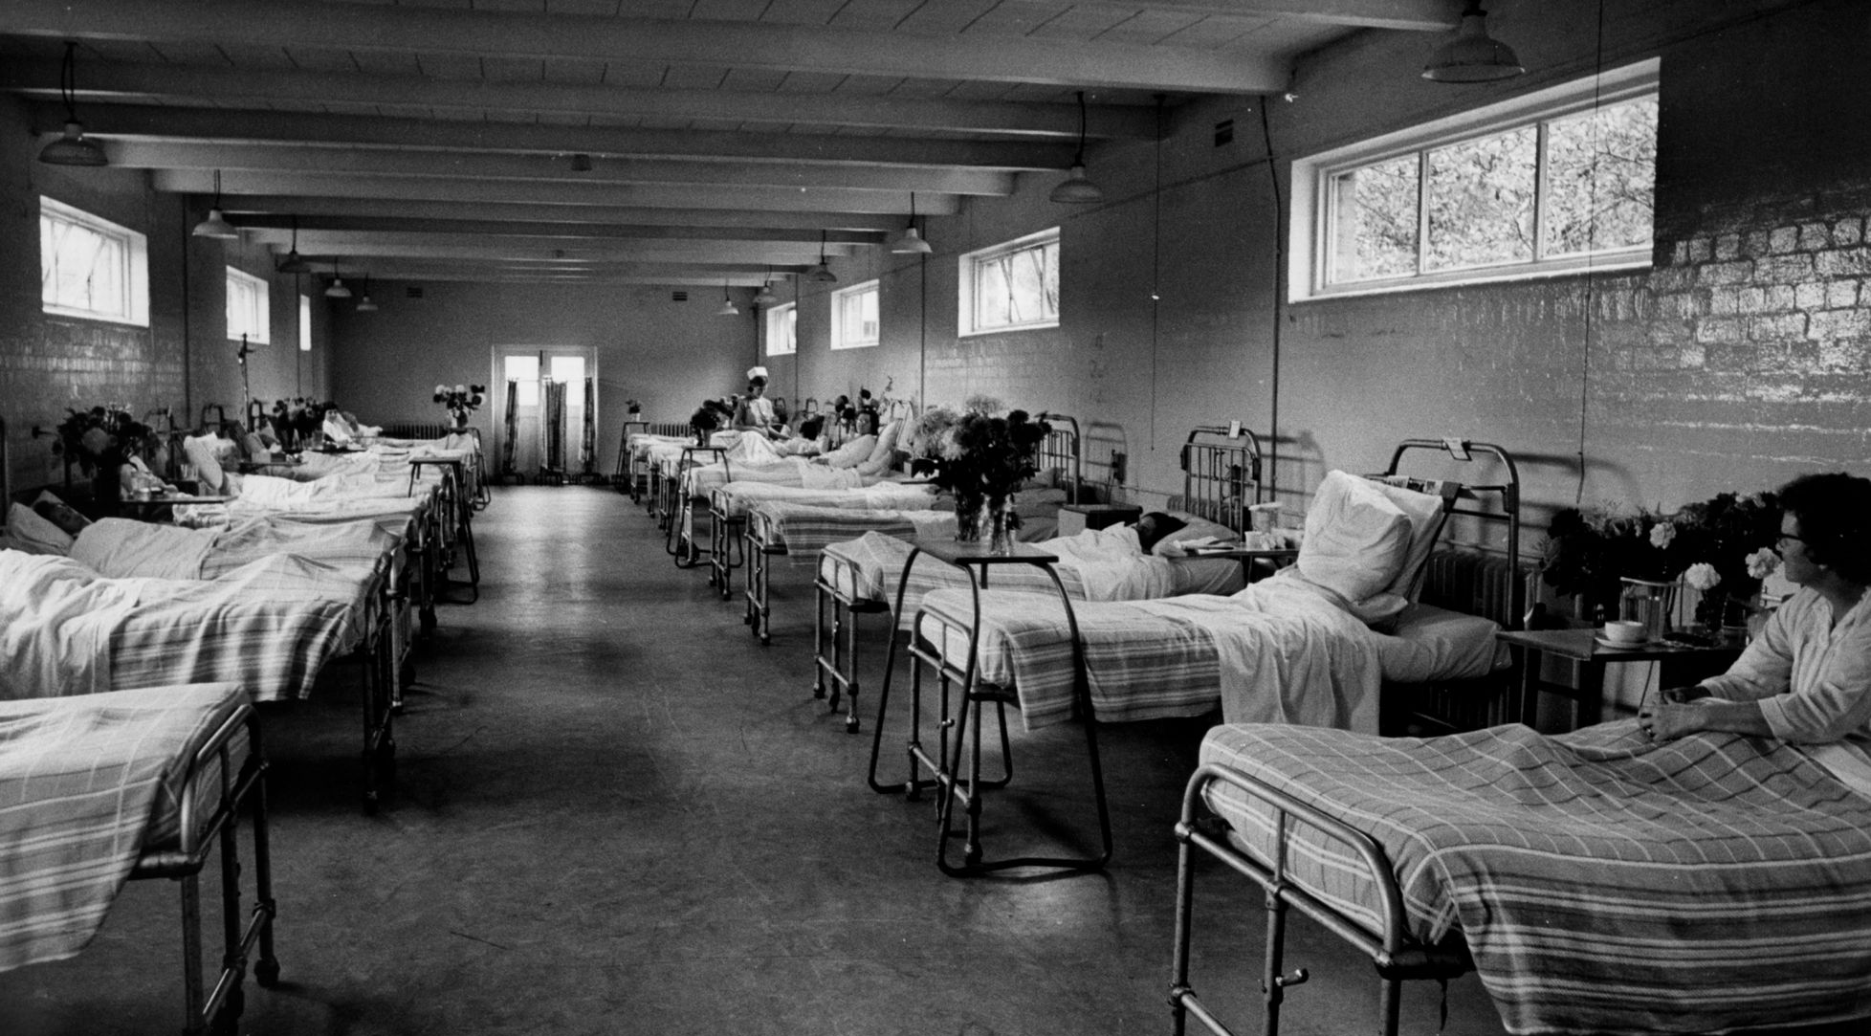
1875
Health issues

Slide 5
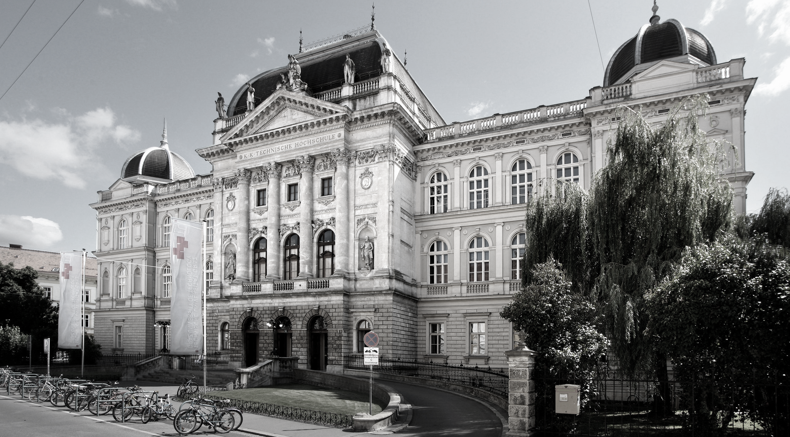
1881
Studies in Graz

Slide 6
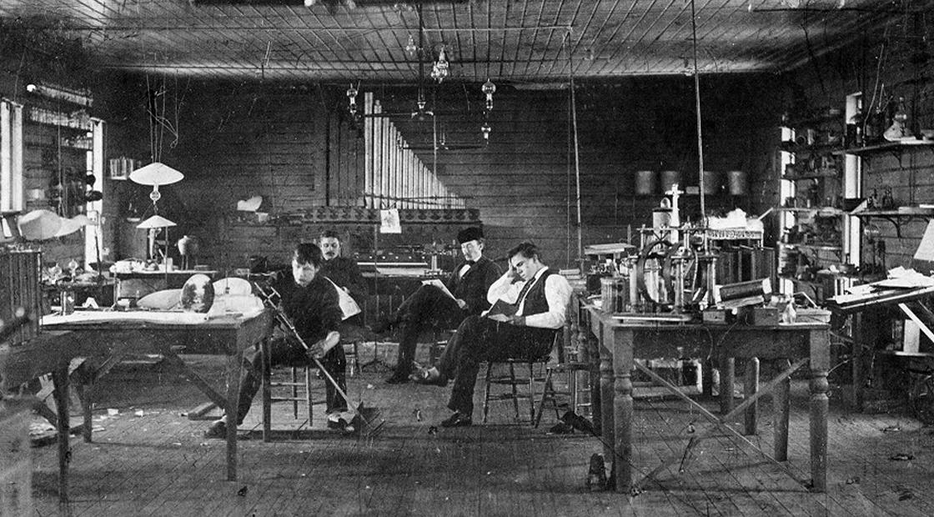
1885
His subordinate jobs

Slide 7
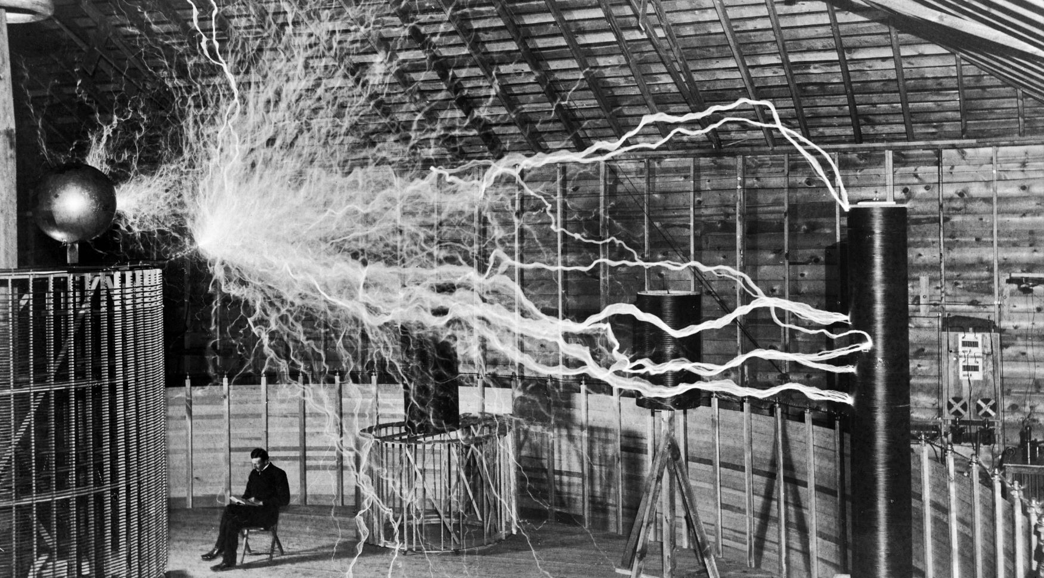
1943
His personal work and death

Slide 8
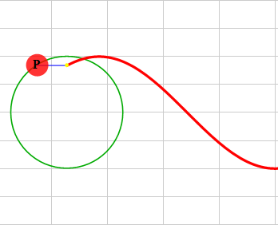
Alternating current
Alternating current periodically reverse direction, following a sinusoidal trend.

Slide 9
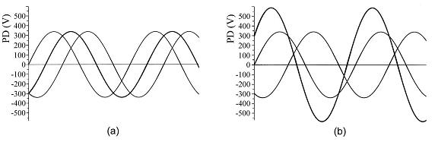
Three-phase
The three-phase system is the most used for AC worldwide.
This Photo by Unknown Author is licensed under CC BY

Slide 10
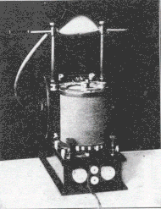
Tesla coil
The first prototype of Telsa coil was made with a glass jar.
The image refers to an early model used for ozone generation.

Slide 11
If you want to find the secrets of the universe, think in terms of energy, frequency, and vibration.
Nikola Tesla

